Slide 1
AGILE PROCESS
Agile is a time boxed , iterative approach to software delivery that builds software incrementally from the start of the project , instead of trying to deliver it all at once near the end.
It works by breaking projects down into little bits of user functionality called user stories , prioritizing them, and then continuously delivering them in short two week cycles called iterations.
In software development life cycle, there are two main considerations, one is to emphasize on process and the
other is the quality of the software and process itself.
Agile software processes is an iterative and incremental based development, where requirements are changeable according to customer needs.
It helps in adaptive planning, iterative development and time boxing.
It is a theoretical framework that promotes foreseen interactions throughout the development cycle.

Slide 2
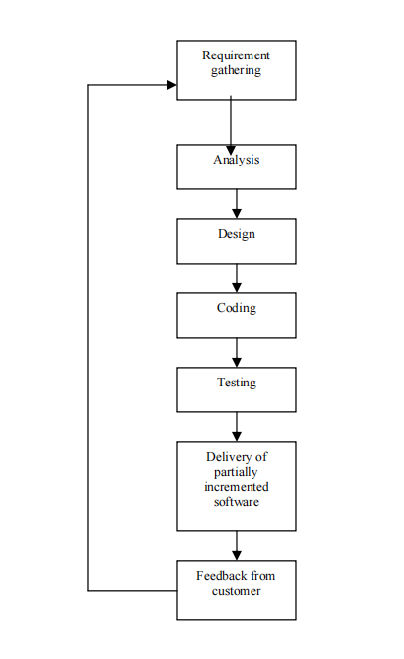
PHASES OF AGILE PROCESS

Slide 3
CHARACTERISTICS OF AGILE PROCESS
Agile process requires less planning and it divides the tasks into small increments.
Agile process is meant for short term projects with an effort of team work that follows the software development life cycle.
Software development life cycle includes the following phases 1.Requirements gathering, 2.Analysis, 3.Design, 4.Coding , 5.Testing, 6.Maintenance.
The involvement of software team management with customers reduces the risks associated with the software.
This agile process is an iterative process in which changes can be made according to the customer satisfaction.
In agile process new features can be added easily by using multiple iterations.
Iterative
2. Modularity
3. Time Boxing
4. Parsimony
5. Incremental
6. Adaptive
7. Convergent
9. Collaborative
10. People Oriented

Slide 4
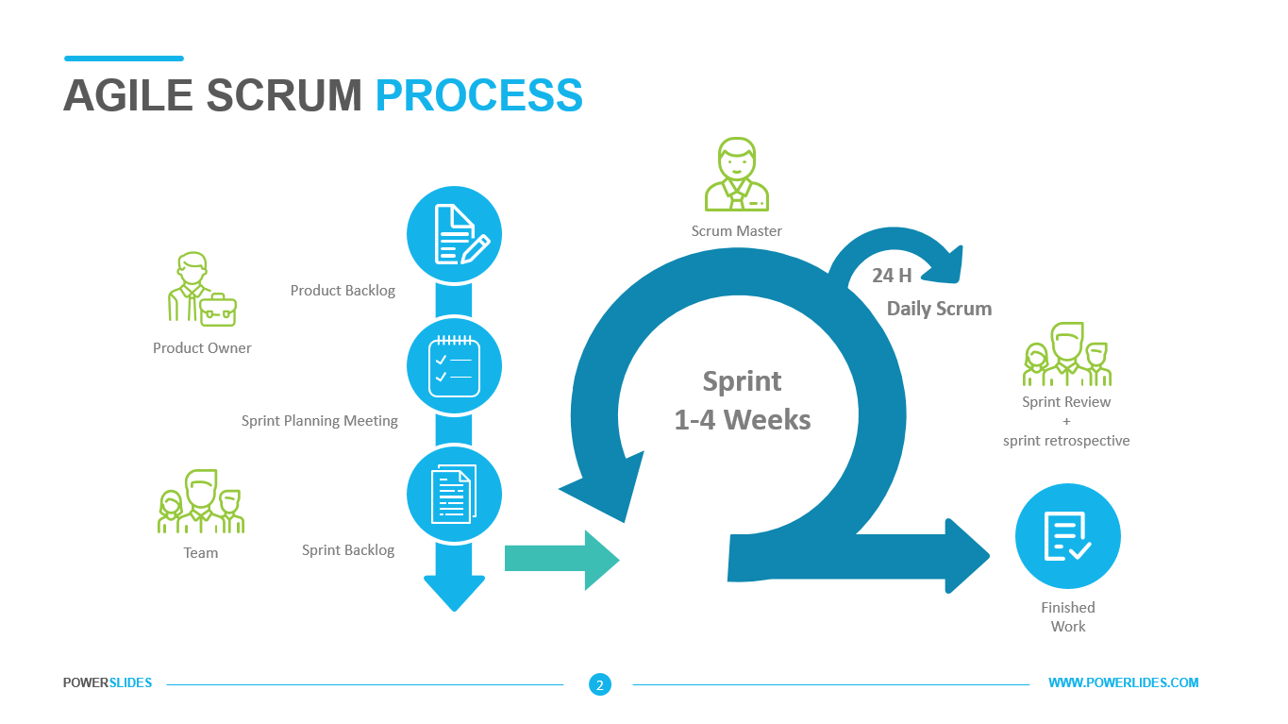
METHODOLOGIES
Scrum
Scrum is another popular method of agile development through which productivity becomes very high. It is basically based on incremental software development process.
In scrum method the entire development cycle is divided into a series of iteration where each iteration is called as a sprint. Maximum duration of a sprint is 30 days.

Slide 5
ADVANTAGES OF AGILE PROCESS
Adaptive to the changing environment
Ensures customer satisfaction
Least documentation
Reduces risks of development

Slide 6
DISADVANTAGES OF AGILE PROCESS
Customer interaction is the key factor of developing successful software
Lack of documentation
Time consuming and wastage of resources because of constant change of requirements
More helpful for management than developer

Slide 7
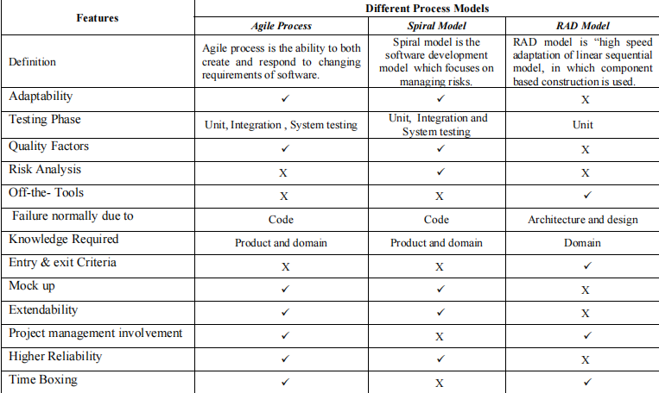
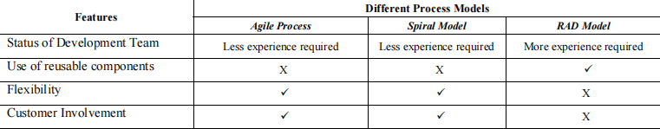
COMPARISON OF AGILE PROCESS WITH OTHER SDLC MODELS

Slide 8
THANK YOU

